Slide 1
Agile estimations

Slide 2
agenda
WHAT IS AGILE?
Why do we estimate in agile?
What is an agile estimation?
how estimate in agile?
Agile Estimation techniques
Estimation for value

Slide 3
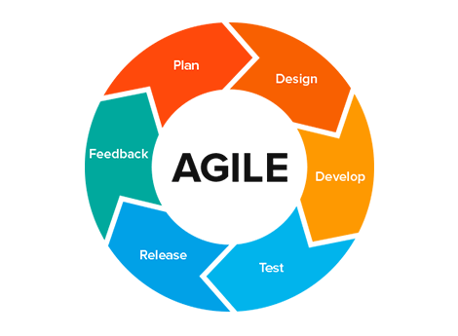
What is Agile?
Group of software development methodologies based on iterative development, where requirements and solutions evolve through collaboration between self-organizing cross-functional teams.
“Agile is a development approach that supports flexibility and rapid response to change.” (Islam, 2013)
Islam, K. A. (2013). Agile Methodology for Developing & Measuring Learning: Training Development for Today's World.

Slide 4
Why do we estimate in agile?
…IF YOU DO IT
Better business decisions
…IF YOU DON’T DO IT
Waste your time
Accurate scope at every level
Healthy discussions
Get team commitment
Build trust → Increase responsability
Spread realistic complexity visión
No time for good decisions
Fear to miss estimate
No knowledge sharing
Individualistic work

Slide 5
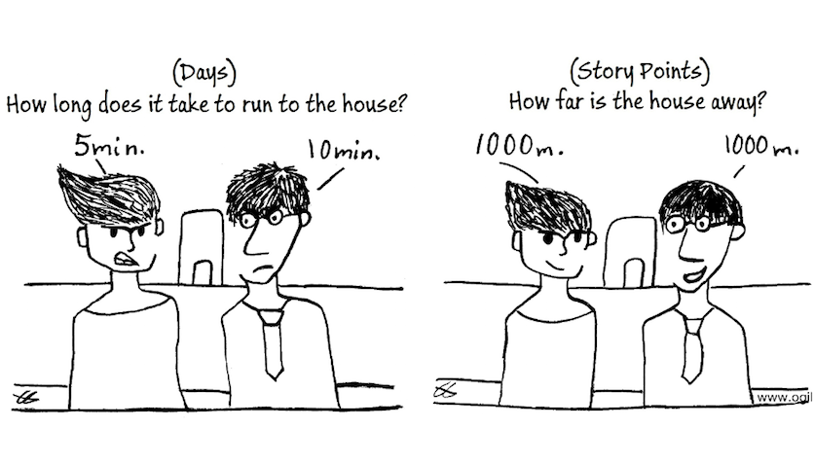
What is an agile estimation?

Slide 6
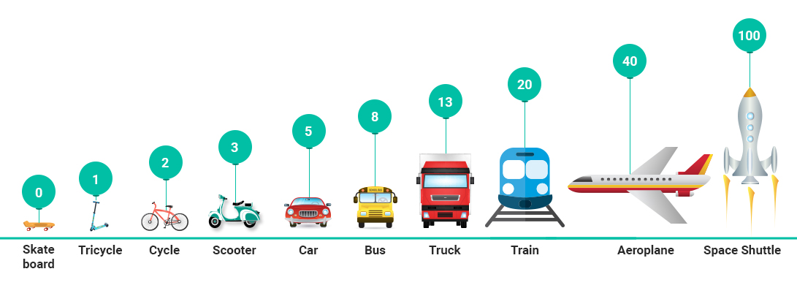
how estimate in agile?
Estimating Size with Story Points
Story points represent the amount of effort, involved in developed and testing a feature, its complexity and the amount of risk inherent in it.
To avoid inaccuracy problem is better to use story points which are used to calculate how many user stories a team can take in a sprint.
“Story points are a unit of measure for expressing the overall size of a user story, feature or other piece of work.”( Cohn, M. 2005, p. 36)

Slide 7
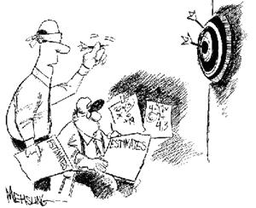
how estimate in agile?
Tips to estimate with Story Points
A two points should be twice as much as a story that is assigned a one. It should also be two-thirds of a story that is estimated as three story points.
Involving everyone (developers, designers, testers, deployers... everyone) on the team is key.
Three Amigos Meeting to accurate the estimation.
Velocity (measured in points) will naturally be different.
Dates don’t account for the non-project related work.
The smallest US should be used as an e.g. to compare it with the bigger ones in order to get additional time upon difficulty.

Slide 8
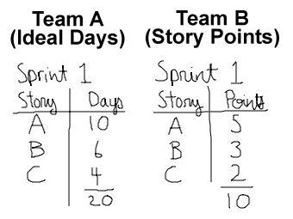
how estimate in agile?
Tips to estimate in ideal days
Ideal time is the amount of time something takes when uncovered of all peripheral activities. (meetings, phone calls, issues)
Elapsed time is the amount of time that passes on a clock (or a calendar).
The story being estimated is the only thing you will work on.
Everything you need will be on hand when you start.
There may be no interruptions.
Sum up all the time that each of the actors in the user story will take

Slide 9

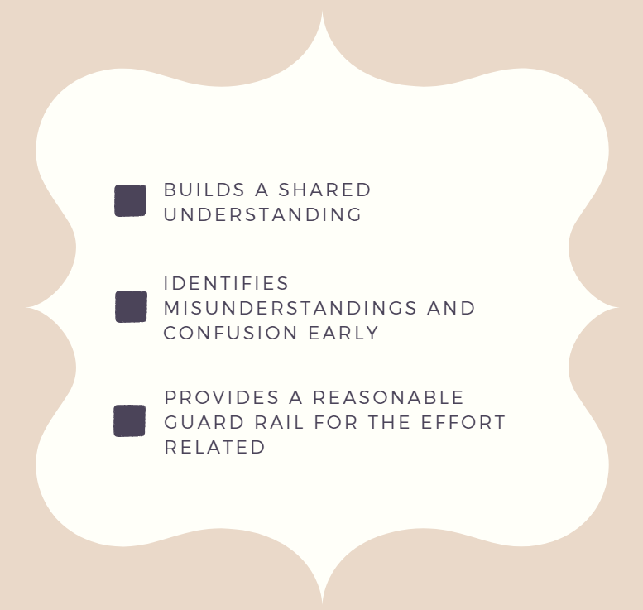
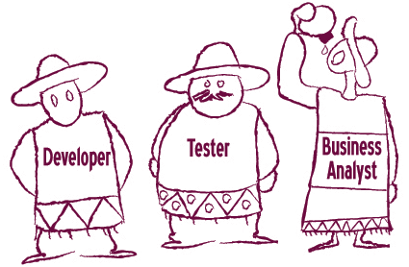
THREE AMIGOS MEETING

Slide 10



Agile Estimation techniques
Expert opinion
Based on EO approach
Analogy
The estimator compares the story being estimated with one or more other stories
Disaggregation
Splitting a story or feature into smaller, easier-to-estimate pieces.
Estimates are assigned to user-valued functionalities
Difficulty finding suitable experts
Very accurate for traditional projects
Risk of going too far and forgetting tasks
Some problems will appear while summing estimates of lots of small tasks
Initial Project phases

Slide 11
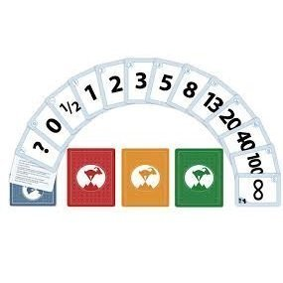
Agile Estimation techniques
Planning Poker
A consensus-based estimating technique
Learning to compare user stories through time
Assign relative story point estimates with any value
Fibonacci sequence scale is the most used
Story points have no limitations to actual hours
The amount of work remains same regardless of the experience.
Story points are inappropriate for hourly build teams when time tracking is important for them.
“Average two-point story takes two or three days to complete, including all testing activities.”

Slide 12
Agile Estimation techniques
XXS
XS
Medium
Large
XL
Small
Larger than XL
T-Shirt size
They aren't additive.
The view of an XL may not match as the other people XL size.
Tend to compare sizes with scales, points or days
Is good for teams that are getting started
Is a more abstract way to size effort without compromising to much
Speeding up the voting process by reducing the options, it may also reduce the accuracy of velocity estimates.
For tracking purposes it will be needed an extra effort to convert to numerical values
Notes:
They aren't additive. You cannot tell a boss you'll be done in 3 mediums, 4 larges, and 2 petites.

Slide 13
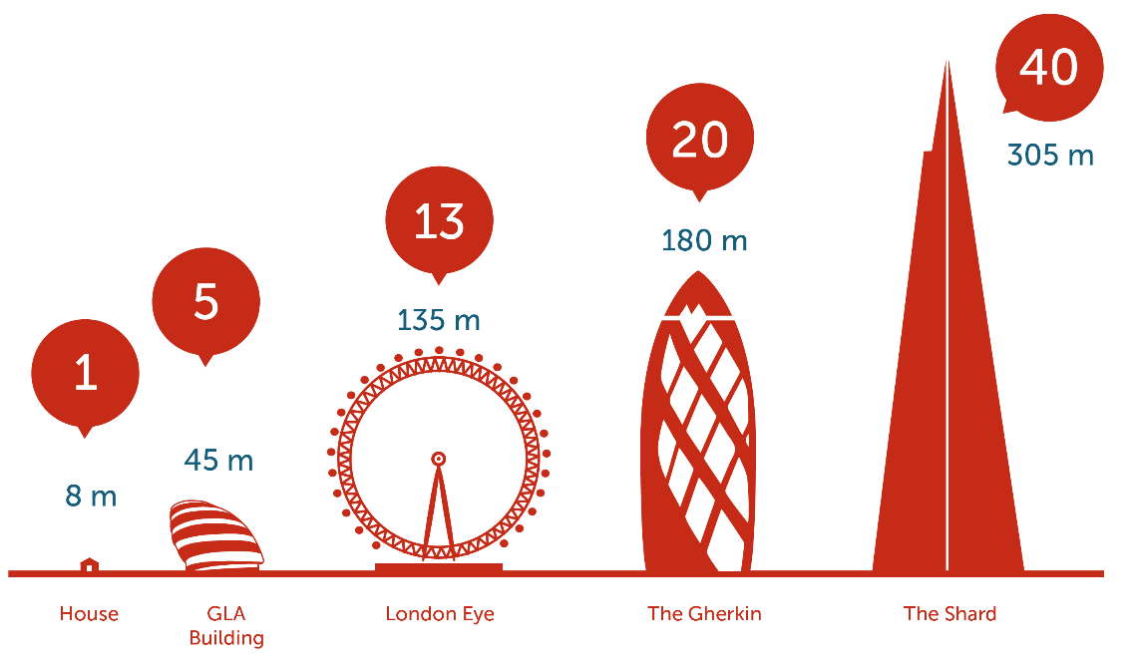
Agile Estimation techniques
Relative Mass Valuation
From the beginning of the project
Helps to prioritize US within size and complexity
Classification instead of estimation
High level estimation with all the team members involved
Huge number of stories estimated within short time
Estimated in order of effort
From qualitative to quantitative estimations
Notes:
They aren't additive. You cannot tell a boss you'll be done in 3 mediums, 4 larges, and 2 petites.

Slide 14
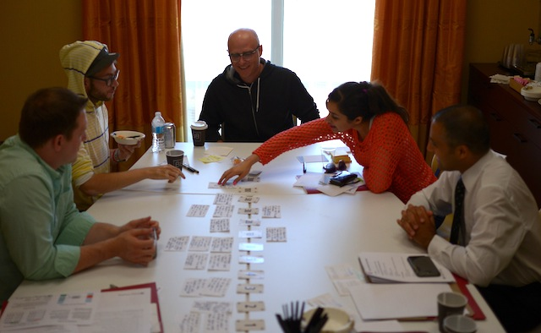
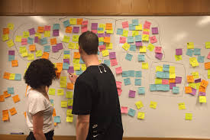
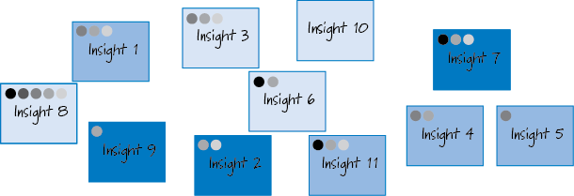
Agile Estimation techniques
The Bucket System
Affinity Mapping
Dot Voting

Slide 15

Estimation for value
By calculating values on estimation, the PO and team can make intelligent decisions about the relative priorities on deliver
The cost can change over time as some features cost less, when implemented later
The best way to reduce the costs of change is to implement the feature as late as possible
There is no reason to take on a high degree of risk for a feature of limited value
Schedule Risk
Cost Risk
Functionality Risk

Slide 16
Q&A
?
¿

Slide 17
Thank you

